Slide 1
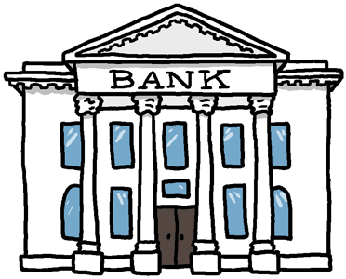
MULTI-BANKING SYSTEM
Guided By:-
Er. Anil Kumar Mishra
Er. Yogmaya Mohapatra
Presented By:-
Gaurav Kumar
Manisha H Sharma
Mohit Agarwal
Nisha H Sharma

Slide 2
Contents
WHY MULTI-BANKING…???
WHAT IS IT???
OBJECTIVES
EXISTING SYSTEM
PROPOSED SYSTEM
ADVANTAGES OF THE PROPOSED SYSTEM
HARDWARE AND SOFTWARE REQUIREMENTS
PROJECT MODULES
ENTITY RELATIONSHIP DIAGRAM
DATA FLOW DIAGRAM
PROJECT SNAPSHOTS
CONCLUSION

Slide 3
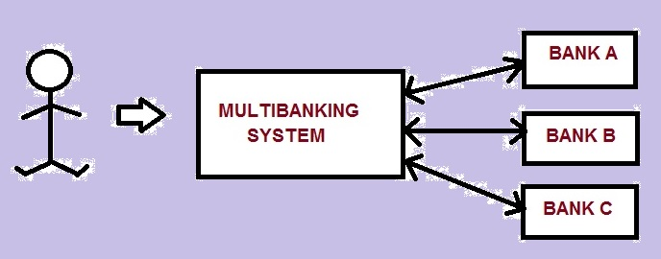
Why multi-banking….???
Currently we are having lot of banks in the market and any person can do transactions of any individual bank either manually or online. But no one can do all banks transactions in a single portal or in single bank.
This is the main disadvantage in existing system to avoid this problem we are introducing “multi- banking system”.

Slide 4

WHAT IS IT???
This interface integrates all existing banks and provides business solutions for both retailers and corporate
Acts as a standard interface between the clients and the banks
Users who have accounts in various banks can login here and can make any kind of transactions
In the backend, system will take care of the entire obligation required in order to carry on transaction smoothly

Slide 5
objectives
The ‘Multi-Banking System’ Interface is targeted to the future banking solution for the users who have multiple bank accounts in different banks. This interface integrates all existing banks and provides business solutions for both retail and corporate.
Maintaining multiple bank accounts through a single portal.
Approving multi-bank account requests by the branch managers.
Approving and opening of new user accounts online.

Slide 6
Existing System
The existing system comprised of single bank portals i.e. one portal for each banking company
Different logins for different banking portals
In the existing system, a user having more than one account in different banks has to do login in their own portals. Hence, they had to maintain separate usernames and password for each of them.

Slide 7
Proposed system
The system provides proper security and reduces the manual work. This application tries to eliminate the difficulties of the existing system and helps the user to reduce the workload and mental conflict. It is very user-friendly. Through this, the users can check their account, transaction and hence it becomes very easy for them. Thinking why multi-banking is so effective and is considered to be the most efficient way of banking? The following are the reasons:
Multi-Banking brings in an organized and proactive banking process
Easy and efficient way of banking
Reduced complexity, reduced paper work and streamlined workflow
Establishes efficient communication channel between users and banks
Dependable database applications available to support banking process

Slide 8
Advantages of proposed system
In this system the database is maintained in centralized manner.
The user can access the entire account information
This system is very fast because of the centralized database and accessing database will be very easy, when compared to the existing system.
The user can also ask any query to support in the website, if any.

Slide 9
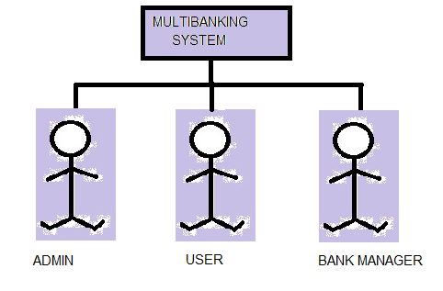
MODULES

Slide 10
PROJECT moduleS
USER MODULE
Delete Account
View Account Information
Update Personal details
Change Password
Transfer Amount
Bill Payment
Transaction Enquires
Billing Enquires
Product & Services and Contact details
Add New Account

Slide 11
ADMIN MODULE :
Pending User Requests
Pending Bank Manager Requests
See Status
See list of banks
Add New Bank
BANK MANAGER MODULE :
User Details
Accounts Details
Transaction Details
Billing Details
New Account Request

Slide 12
HARDWARE REQUIREMENTS
Processor | : | Pentium IV or above
Hard Disk | : | 40 GB
RAM | : | 512 MB
CPU Speed | : | 2.6 GHz
Monitor | : | EGA/SVGA (display), 800x600
Mouse | : | PS2/ Optical Mouse
SOFTWARE REQUIREMENTS
Operating System | : | Windows XP/7/8
IDE Tool | : | My Eclipse 8.6
Framework | : | Struts 2
Client Side Scripting | : | JavaScript, HTML, CSS
Server Side Scripting | : | Java(JDK 6.0)
Programming Language | : | Java(JDK 6.0)
Database | : | Oracle 10g XE
Web Requirements | : | JSP, Servlet
Web Server | : | Apache TomCat 6.x
Web Browser | : | Any Browser

Slide 13
Entity-relationship diagram
Entity–relationship model (ER model) is a data model for describing the data or information aspects of a business domain or its process requirements, in an abstract way that lends itself to ultimately being implemented in a database such as a relational database. The main components of ER models are entities (things) and the relationships that can exist among them, and databases.

Slide 14
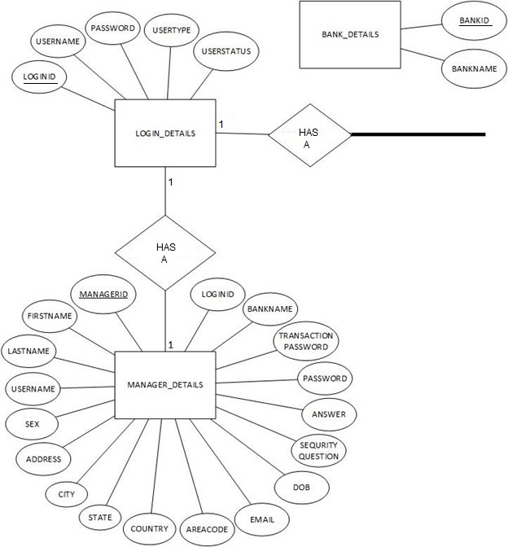

Slide 15
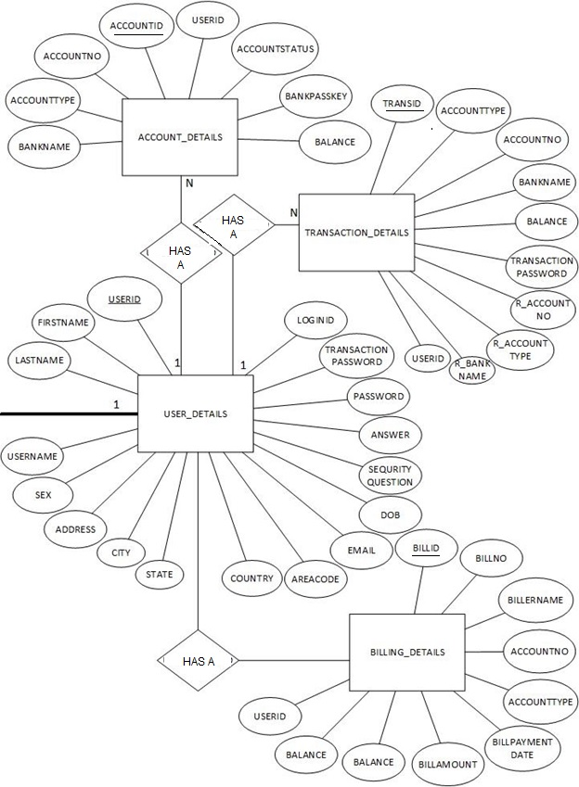
Continued…
1
N

Slide 16
DATA FLOW DIAGRAM
A Data flow diagram (DFD) is a graphical representation of the flow of data through an information system. It differs from the system flowchart as it shows the flow of data through processes instead of computer hardware.
Data flow diagrams are one of the three essential perspectives of Structured System Analysis and Design Method.
The DFD is designed to show how a system is divided into smaller portions & to highlight the flow of data between those parts.

Slide 17
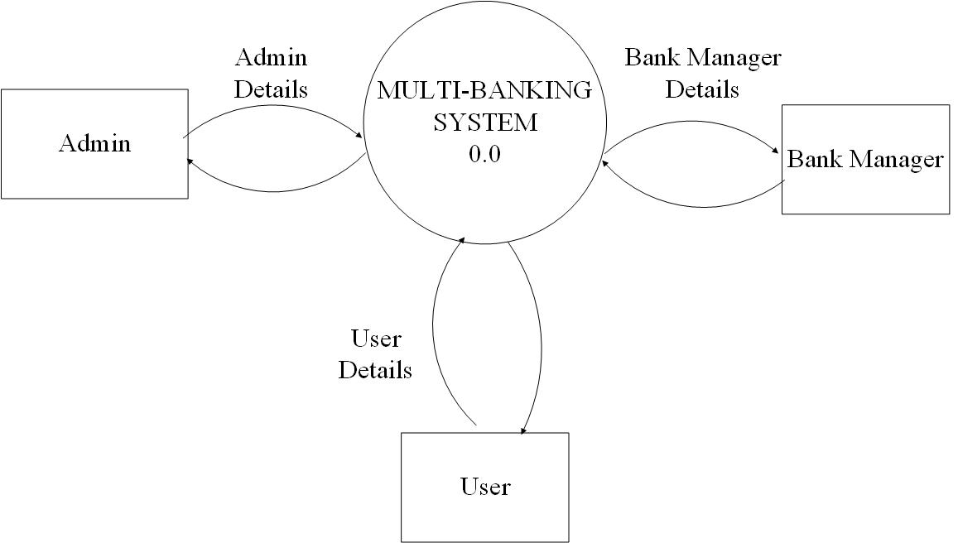
Level 0 (context level diagram)

Slide 18
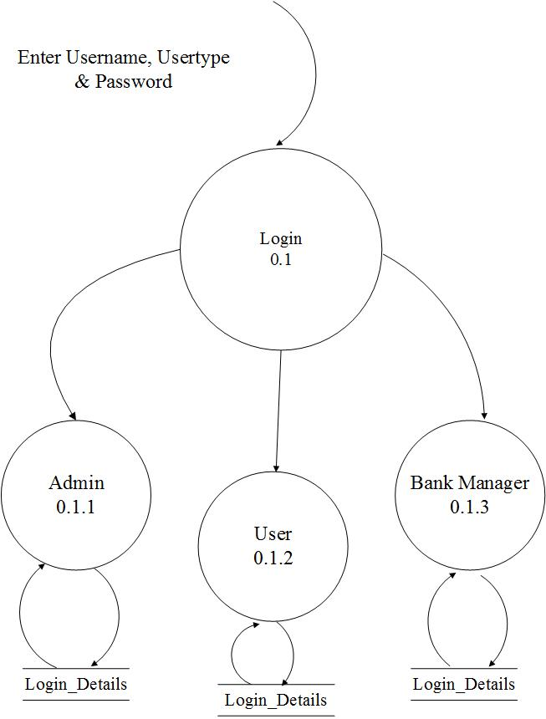
Level-1

Slide 19
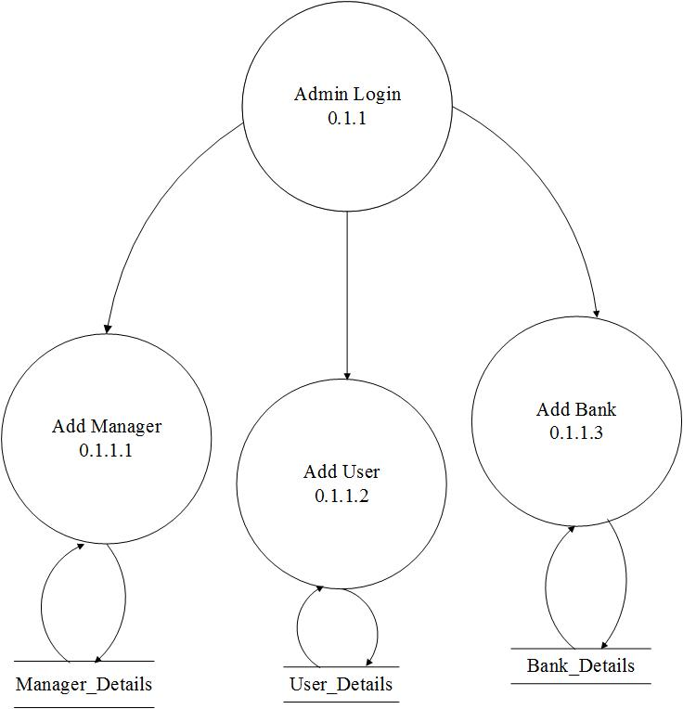
Level 2 (Admin module)
Add
Add
Add

Slide 20
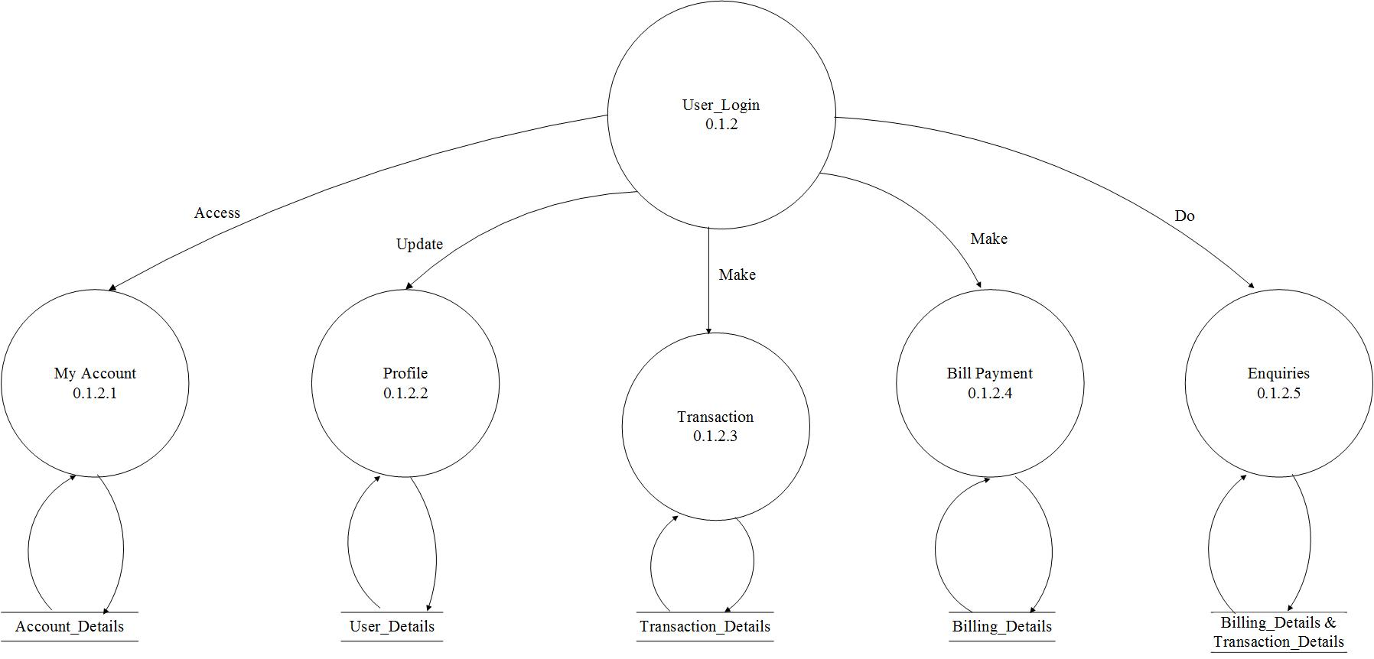
Level 2 (USER module)

Slide 21
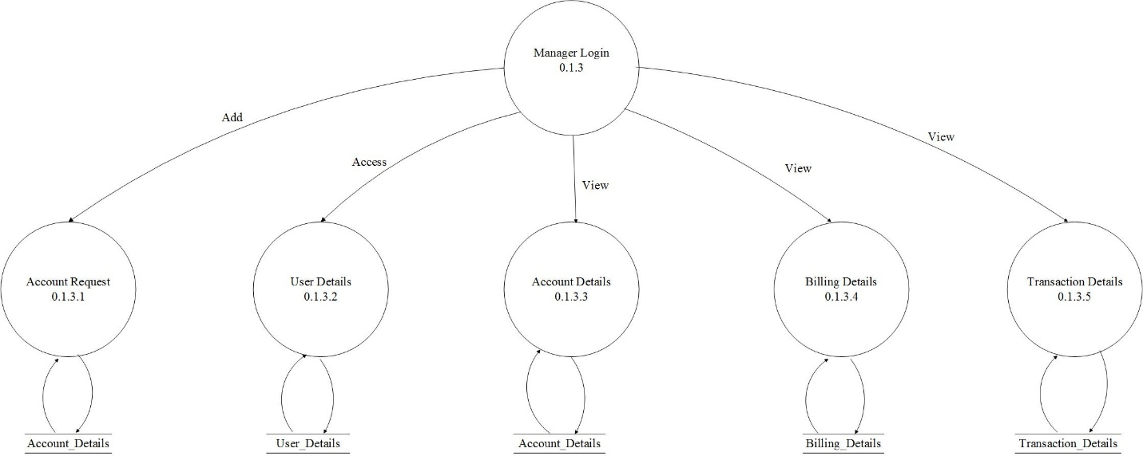
Level 2(BANK Manager module)

Slide 22
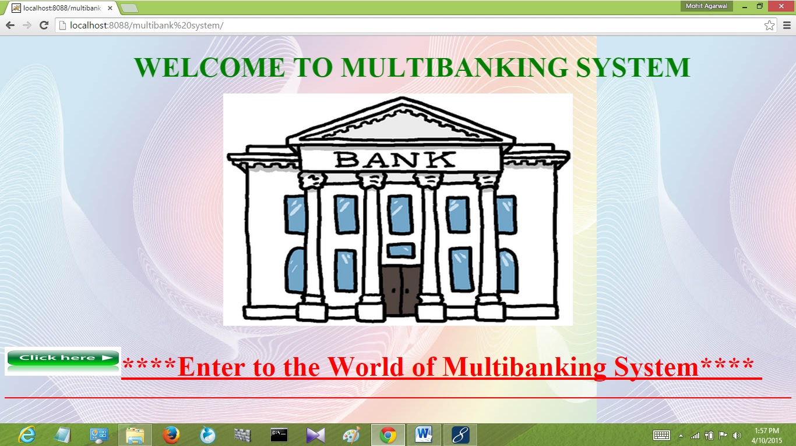
Project snapshots

Slide 23
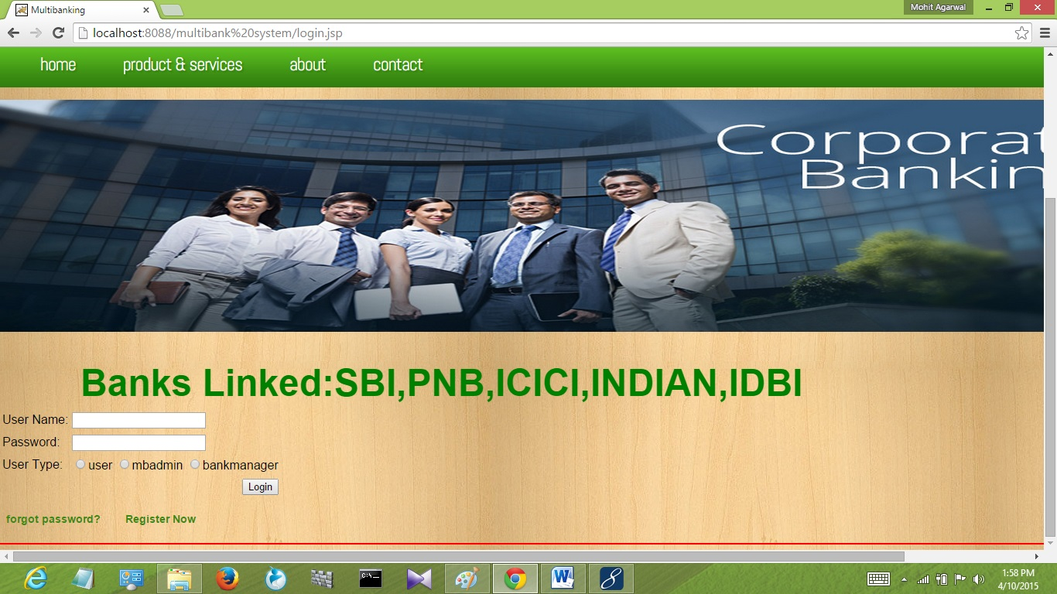

Slide 24
conclusion
Hence, the multi-banking system is a simple and intuitive program that not only connects the existing bank accounts but also eases a lot of the customers who are having more than one banking accounts and hence more than one single banking portals i.e. one portal for each bank account. The multi-bank portal is better in every aspect as it merges all the bank accounts of a user to a single portal and makes it convenient for the user to do a lot of banking operations. Now, as all the bank accounts are merged to one portal and hence, for that reason the viable permissions are needed from one and all banking companies, so, encryption techniques and security measures of all the types of banks are also merged. Hence, making the portal heavily secured and user-friendly and very convenient to use

Slide 25

O;

